Slide 1

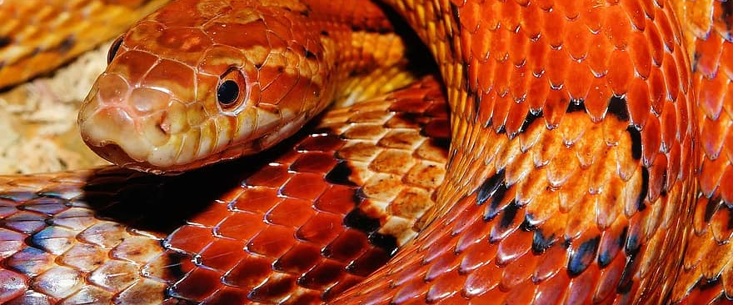
RECURSION
^{python style}
^{Richard Tillies, M.S.}
^{Instructor Candidate}
Wake Technical Community College
^{June 17, 2024}
Notes:
Good morning, my name is Richard Tillies, candidate for the 12M Computer Programming Instructor position.
I will present today on Recursion in Python.

Slide 2
Recursion
A recursive function is a function that calls itself
The base case is the solution to the problem without recursion.
The recursive case calls itself with a simpler version as it moves toward the base case
Any recursive problem can be solved with iteration (loops)
Notes:
To understand recursion, it would be helpful to understand recursion.
So let's define it.
(click)
A recursive function is a function that calls itself.
For it to work properly, it needs two parts or cases.
(click)
The base case is the solution without the need for recursion.
(click)
The recursive case is the part that calls itself.
Each recursive call needs to move closer to the base case, or it will continue forever.
Think of it like an infinite loop, but worse.
An infinite loop is like your faucet running forever down the drain.
Infinite recursion is the faucet running into a stopped sink, flooding your house.
(click)
Speaking of loops, any recursion problem can be solved with iteration.
So why would you ever use recursion? Sometimes, the recursive solution is simpler to understand. Or more elegant. We will dive into some examples.

Slide 3



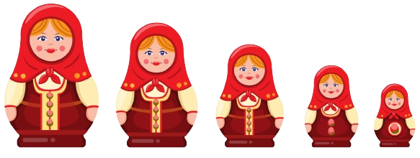
Matryoshka Nesting Dolls
eat_candy
open_doll
Notes:
Think of the Matryoshka nesting dolls, The inner most doll has candy, or a toy, or coal, I don't really know. Let's just assume candy.
But when you open the doll, there's a slightly smaller doll inside, and you repeat the process until you get to the candy.
(click)
The candy is the base case. You're done.
(click)
But if it's another doll, you open the doll. That's the recursive case.

Slide 4
Recursive Factorial
4! = 4 * 3 * 2 * 1 = 24
4! = 4 * 3!
3! = 3 * 2!
2! = 2 * 1!
1! = 1 * 0!
0! = 1
Notes:
So let's look at a different problem that we can solve with recursion.
If you remember high school math, and who doesn't, you probably remember factorial.
(click)
The factorial of a number is the product of all the positive integers from the number down to 1. So 4 factorial, written as 4!, is 4*3*2*1 = 24.
But if we look closely, this part would be 3!
(click)
So 4! is the same as 4 * 3!
And we can repeat that process.
Factorial of a number is that number times the factorial of the number below it.
(click) 3! = 3 * 2!
(click) 2! = 2 * 1!
(click) 1! = 1 * 0!
And 0! is our base case. 0! = 1
(click)
The base case is 0. 0! = 1
(click)
The recursive case is any number greater than 0. And my program has logic that ensures the user enters a positive integer.

Slide 5
Recursive Factorial
4! = 4 * 3 * 2 * 1 = 24
4! = 4 * 3!
3! = 3 * 2!
2! = 2 * 1!
1! = 1 * 0!
0! = 1
= 4 * 6 = 24
= 3 * 2 = 6
= 2 * 1 = 2
= 1 * 1 = 1
Notes:
So we can replace 0! in this equation with 1
(click)
1 * 1 = 1
We can replace 1! in this equation with 1
(click)
2 * 1 = 1
This process continues.
Replace 2! with 2
(click) 3 * 2 = 6
Replace 3! with 6
(click) 4 * 6 = 24
So we get our correct answer.

Slide 6
# recursive factorial
def fact(n):
if n == 0:
return 1
else:
return n * fact(n-1)
# base case
# recursive case
* for non-negative integer values of n
Notes:
Here's what it looks like in Python.
(click)
Define the factorial function, we'll call it fact for short.
It takes one argument, we'll call it n.
(click)
Here's our base case, if n = 0, return 1
Because 0! = 1
(click)
Here's the recursive case.
Multiply n * factorial of n-1, and return that.
Again, for non-negative integer values.
The program has logic that ensures the user enters a positive integer.

Slide 7
n
fact(4)
4
def fact(n):
if n == 0:
return 1
else:
return n * fact(n-1)
fact(4)
Notes:
So let's call fact(4). We already know that's 24, but let's get there Pythonically.
We have a call stack on the left, let's add stuff to it as we go.
There's also an n tracker on the top right for those playing at home.
(click)
Add fact(4) to the stack.
(click)
Check if n is equal to 0.
It does not. Jump to the else.
(click)
return n * factorial of n-1
so 4 * fact(3)

Slide 8
n
4 * fact(3)
3
def fact(n):
if n == 0:
return 1
else:
return n * fact(n-1)
4 * fact(3)
fact(4)
Notes:
So we're at 4 * fact(3). Let's add that to the stack.
n is now 3.
(click)
Does n = 0?
Nope. Else.
(click)
return n * factorial of n-1
n = 3, so 3 * fact(2)

Slide 9
n
3 * fact(2)
2
def fact(n):
if n == 0:
return 1
else:
return n * fact(n-1)
3 * fact(2)
4 * fact(3)
fact(4)
Notes:
3 * fact(2). Add it to the stack
n is now 2.
(click)
Does n = 0?
Still no. Else.
(click)
return n * factorial of n-1
n = 2, so 2 * fact(1)

Slide 10
n
2 * fact(1)
1
def fact(n):
if n == 0:
return 1
else:
return n * fact(n-1)
2 * fact(1)
3 * fact(2)
4 * fact(3)
fact(4)
Notes:
2 * fact(1) goes on the stack. n is 1.
(click)
Does n = 0?
Nah but we're getting closer.
I'm glad, because my sink doth overflow soon.
(click)
Down to the else.
n * factorial of n-1
n = 1, so 1 * fact(0)

Slide 11

n
1
1 * fact(0)
0
1 * fact(0)
def fact(n):
if n == 0:
return 1
else:
return n * fact(n-1)
2 * fact(1)
3 * fact(2)
4 * fact(3)
fact(4)
Notes:
1 * fact(0) is on the stack.
And I think we've hit the jackpot.
Or base case.
(click)
Does n = 0?
Yes. It. Does.
(click)
return 1
(click)
fact(0) = 1

Slide 12
n
1
1 * fact(0)
0
1 * fact(0)
def fact(n):
if n == 0:
return 1
else:
return n * fact(n-1)
2 * fact(1)
3 * fact(2)
4 * fact(3)
fact(4)
Notes:
And now we can evaluate what's on the stack.
(click)

Slide 13
n
1
1 * fact(0)
0
1 * fact(0)
1
*
=
1
2 * fact(1)
3 * fact(2)
4 * fact(3)
fact(4)
Notes:
fact(0) = 1
(click)
So 1 * 1 = 1
(click)
fact(1) = 1

Slide 14
n
2 * fact(1)
1
1
2 * fact(1)
2
*
=
2
3 * fact(2)
4 * fact(3)
fact(4)
Notes:
fact(1) = 1
2 * 1 = 2
(click)
fact(2) = 2

Slide 15
n
3 * fact(2)
2
2
3 * fact(2)
3
*
=
6
4 * fact(3)
fact(4)
Notes:
fact(2) = 2
3 * 2 = 6
(click)
fact(3) = 6

Slide 16
n
4 * fact(3)
3
6
4 * fact(3)
4
*
=
24
fact(4)
Notes:
fact(3) = 6
4 * 6 = 24
(click)
fact(4) = 24

Slide 17
n
fact(4)
= 24
4
24
fact(4)
Notes:
fact(4) = 24 Q.E.D.
Let's look at the code.

